Slide 1
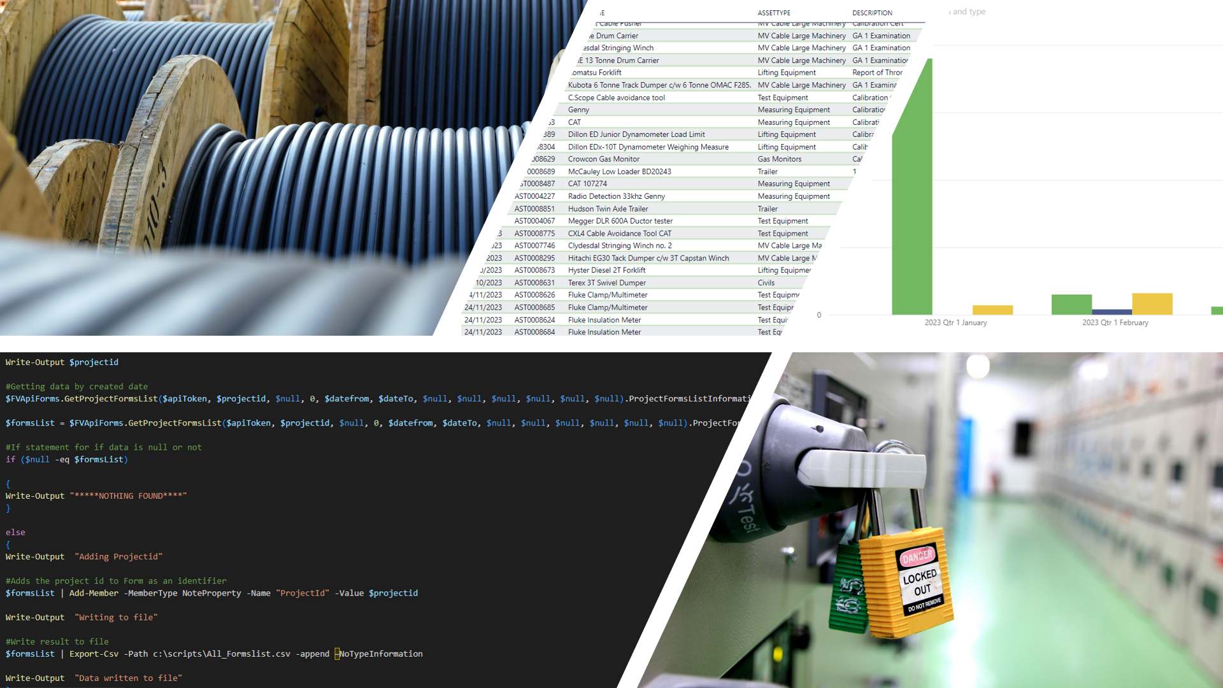
KPI WITH POWERBI
Streamlining report building with PowerBI and PowerShell

Slide 2
Problem & PRIMARY Objective
Problem: Staff manually pulling data and processing data into report visuals.
Objective: Streamline and automate the process

Slide 3
USE CASE – Time SAVING
A user spends 1.5 hour every week to access Fieldview and compile a report of the amount of vehicle reports submitted by staff that week. 1.5 hours x 48 working weeks = 72 Hours which equates to 9 working days per year.
Annual Salary €45k = 173.08 per day * 9 working days = €1557.72

Slide 4
NEW PROCESS

Slide 5




TECHNOLOGIES USED
PowerBI
PowerShell
DAX
SharePoint

Slide 6
Project Completion INCORPORATED SYSTEMS
SMARTSHEETS – Visual of Timesheet
FIELDVIEW - Visual of Vehicle Check Sheets
PIPEDRIVE – Visual of Business Development
ASSET MANAGER – Scheduled service
OFFICE365 – Reference data

Slide 7
THANK YOU FOR WATCHING
Anders Ingelsten
20095402@mail.wit.ie
http://ingelsten.surge.sh/

